Slide 1
Data Visualization Data Visualization techniques involve the generation of graphical or pictorial representation of DATA, form which leads you to understand the insight of a given data set. This visualisation technique aims to identify the Patterns, Trends, Correlations, and Outliers of data sets.

Slide 2
Benefits:
Patterns in business operations: Data visualization techniques help us to determine the patterns of business operations.
Identify business trends.
Storytelling and Decision making
Understand the current business insights and setting the goals.
Operational and Performance analysis.

Slide 3
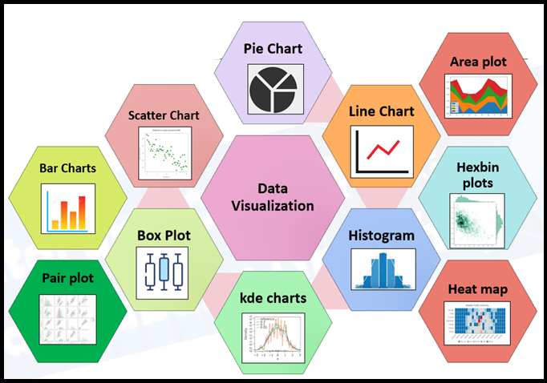
Data Visualization in Data Science
Data visualization techniques most important part of Data Science, There won’t be any doubt about it. And even in the Data Analytics space as well the Data visualization doing a major role. We will discuss this in detail with help of Python packages and how it helps during the Data Science process flow. This is a very interesting topic for every Data Scientist and Data Analyst.

Slide 4
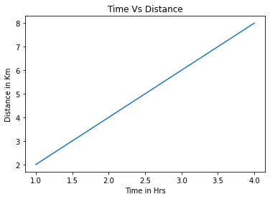
I. Line Chart
Line Chart is a simple data visualization in Python, which is available under Matplotlib.
# Sample #1 # importing the required libraries import matplotlib.pyplot as plt import numpy as np #simple array x = np.array([1, 2, 3, 4]) #genearting y values y = x*2 plt.plot(x, y) plt.show() #Sample #2 x = np.array([1, 2, 3, 4]) y = np.array([2, 4, 6, 8]) plt.plot(x, y) plt.xlabel("Time in Hrs") plt.ylabel("Distance in Km") plt.title("Time Vs Distance") plt.show(

Slide 5
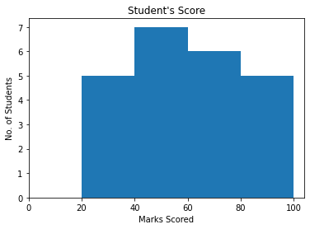
II.Histogram¶
The histogram is the graphical representation of a set of numerical data distribution across. It is a kind of bar plot with X-axis and Y-axis represents the bin ranges and frequency respectively
from matplotlib import pyplot as plt import numpy as np fig,ax = plt.subplots(1,1) a = np.array([25,42,48,55,60,62,67,70,30,38,44,50,54,58,75,78,85,88,89,28,35,90,95]) ax.hist(a, bins = [20,40,60,80,100]) ax.set_title("Student's Score") ax.set_xticks([0,20,40,60,80,100]) ax.set_xlabel('Marks Scored') ax.set_ylabel('No. of Students') plt.show()

Slide 6
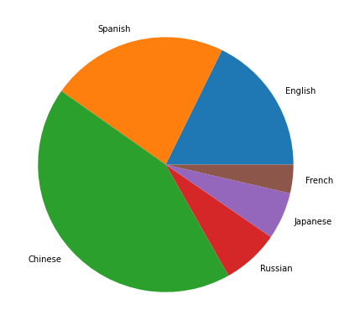
III.Pie Chart
This is a very familiar chart and representation statistical plot in the form of circular from series of data. This is commonly used in business presentations to represent Order, Sales, Profit, Loss, etc.,
from matplotlib import pyplot as plt import numpy as np Language = ['English', 'Spanish', 'Chinese', 'Russian', 'Japanese', 'French'] data = [379, 480, 918, 154, 128, 77.2] # Creating plot fig = plt.figure(figsize =(10, 7)) plt.pie(data, labels = Language) # show plot plt.show()

Slide 7
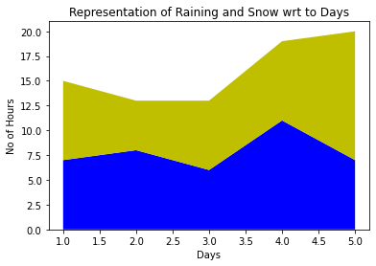
IV. Area plot
This is very similar to a line chart with fencing surrounded by a boundary line of different colours. Simple representation of the evolution of a numeric variable.
import matplotlib.pyplot as plt
days = [1, 2, 3, 4, 5]
raining = [7, 8, 6, 11, 7]
snow = [8, 5, 7, 8, 13]
plt.stackplot(days, raining, snow,colors =['b', 'y'])
plt.xlabel('Days')
plt.ylabel('No of Hours') plt.title('Representation of Raining and Snow wrt to Days')
plt.show()

Slide 8
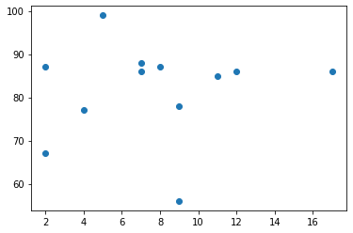
V. Scatter plots¶
Scatter plots are used to plot data points across both axes (Horizontal and Vertical) and represent how each axis correlated with each other. Mostly in Data Science/Machine Learning implementation and before the EDA process, generally we should analyse how dependent and independent aligned. It could positive or Negative or sometimes be scattered across the graph.
import matplotlib.pyplot as plt x = [5,7,8,7,2,17,2,9,4,11,12,9] y = [99,86,87,88,67,86,87,78,77,85,86,56] plt.scatter(x, y) plt.show()

